Slide 1
Introduction

Slide 2
Unix – In today’s World
First of all Mac OS core is UNIX based. A lot of electronics are LINUX based.
Nowadays the UNIX OS is used as servers in many business organizations.
In telephone exchange the UNIX server is used as the call connecion server.

Slide 3
Facts about UNIX
Unix is an Operating System, as well as a standard that other Operating Systems use.
Linux is based on UNIX, though, it's not an actual derivation of it. People use the kernel to create their own Operating Systems.
Also, Unix, is generally used for servers, where Linux is used for Personal Computers.

Slide 4
Several features of UNIX that made it very popular:
Portable
Portability is a characteristic attributed to a computer program if it can be used in an operating systems other than the one in which it was created without requiring major rework.
UNIX found on more hardware platforms than any other OS.
It was developed using the C language.
Because C programs are easily moved from one hardware to another, it is relatively simple to port it to different environment.

Slide 5
Multiuser
The UNIX design allows multiple users to concurrently share hardware and software.
The UNIX resource-sharing algorithms allow them to share the resources while at the same time preventing any one user from locking out others.
Multitasking
It is capable of carrying out more than one job at the same time. It allows user to type in a program in its editor while it simultaneously executes some other commands like sort, copy a huge file.
The later job is performed in the background while in the foreground uses the editor or takes a directory listing or anything else.

Slide 6
Communication
The communication may be within the network of a single main computer or between two or more such computer networks.
The users can easily exchange mail, data programs through such networks.
Organized File System
UNIX has a very organized file and directory system that allow users to organize and maintain files.

Slide 7
Device Independence
UNIX treats I/O devices like ordinary files.
The input to a program can come from any device or file and output of the program can go to any device or file.
The source and destination for file I/O is easily controlled through a UNIX design feature redirection.
Utilities
Productivity is directly proportionate to the software available on a system.
There are more than 100 utilities that a user can use in a UNIX system.
Notes:
IX

Slide 8
Security
Provides user security using authentication features like password protection/ controlled access to specific files/ encryption of data.
Open Source
Source code is freely available and it is community based development project. Multiple teams works in collaboration to enhance the capability of Linux operating system and it is continuously evolving.

Slide 9
UNIX Structure
The UNIX operating system is a set of programs that act as a link between the computer and the user.
The computer programs that allocate the system resources and coordinate all the details of the computer's internals is called the operating system or kernel.
Users communicate with the kernel through a program known as the shell. The shell is a command line interpreter; it translates commands entered by the user and converts them into a language that is understood by the kernel.

Slide 10
Unix Structure OR Block Diagram
UNIX consists of Three major components:
The kernel
The shell
Command and utilities

Slide 11
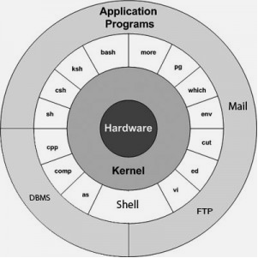

Slide 12
The Kernel
The kernel is the heart of the UNIX system.
It is a program which is loaded in memory when system is turn on. It stay there and provides various services until the system is turned off.
It interacts with hardware directly. When user program needs to use any hardware, it has to use services provided by the kernel. Special program like system calls are used to request kernel.
It also provides services to user like memory management, task scheduling and file management.
It manage entire computer system.

Slide 13
The Shell
The shell is the part of UNIX that is most visible to the user.
It is an interface between user program and the kernel.
When user log in to the system, process for shell start execution. It terminate when user log-out from the system.
User directly interact with the shell.
Shell provides the prompt to the user where user can enter their command.
There are two major parts of a shell.

Slide 14
The Shell (cont)
First is It works as a command interpreter. It accepts command from user and translates them into the form which the kernel understand easily.
Second is It is also a programming language. It provide programming functionalities such as looping, branching and so on.. that allows programmers to write a shell script.
A shell script is a file that contains shell commands that perform a useful function.
It is also known as a shell program.

Slide 15
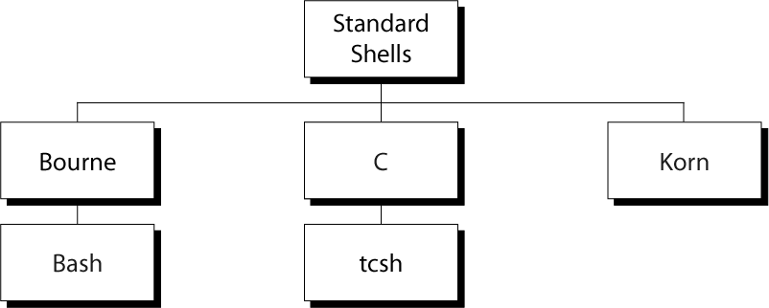
Some Standard UNIX Shells
SHELL | PROMPT
Bourne | $
C Shell | %

Slide 16
Command & Utilities
Utility is a standard UNIX program that provide support process fro user.
Command refers to the program and any arguments you specify to that program to change its behavior.
There are various command and utilities which you would use in your day to day activities.
Three common utilities are text editors, search programs, and sort programs.
For Example: “ls” list utility display the files that reside on the disk.
There are over 250 command provided through third party software.
All the command come along with various optional options.

Slide 17
Utilities Vs Command
Utilities are programs you can run or execute
Commands are slightly different than utilities. The term utility refers to the name of a program,
whereas the term command refers to the program and any arguments you specify to that program to change its behavior.
You might see the term command used instead of the term utility for simple commands, where only the program name to execute is given.

Slide 18
Command
In UNIX, a command is a program that you can run.
In other operating systems, such as Mac OS or Windows, you point to the program you want to run and click it. To run a command in UNIX, you type its name and press Enter.
For example: $ date [ENTER]
Wed Dec 9 08:49:13 PST 2017
$
Here, the date command has been entered. This command displays the current day, date, time, and year. After the current date appears, notice that the $ character is displayed.

Slide 19
Command
$ character to indicate the prompt.
Wherever you see a prompt, you can type the name of a command and press Enter.
This executes the command that you type.
While a command executes, the prompt is not displayed.
When the command finishes executing, the prompt is displayed again.

Slide 20
Simple Command
A simple command is one that you can execute by just giving its name at the prompt:
$ command
Here, command is the name of the command you want to execute.
For Example : $date

Slide 21
Complex Command
Complex command is a command that consists of a command name and a list of arguments.
Arguments are command modifiers that change the behavior of a command.
For Example : $ who am I
In this case, the command name is who, and the arguments are am and i.
The arguments am and i change the behavior of the who command to list information about you.
Syntax : $ command argument1 argument2 argument3 ... argumentN
Here, command is the name of the command you want to execute, and argument1 through argumentN are the arguments you want to give command.

Slide 22
Compound Command
A compound command consists of a list of simple and complex commands separated by the semicolon character ( ;).
For Example : $ date ; who am i ;
Wed Dec 9 10:10:10 PST 1998
ranga pts/0 Dec 9 08:49
$
Here, the compound command consists of the simple command “date” and the complex command “who am I”.
As you can see from the output, the date command executes first, followed by the who am i command. When you give a compound command, each of the individual commands that compose it execute in order.

Slide 23
Compound Command
The semicolon character ( ;) is treated as a command separator, which indicates where one command ends and another begins.
If you don't use it to separate each of the individual commands in a complex command, the computer will not be able to tell where one command ends and the next command starts.
If you execute the previous example without the first semicolon
$ date who am i
an error message similar to the following will be produced:
date: bad conversion

Slide 24
Types of Shell

Slide 25
SHELL | DESCRIPTION
Bourne Shell | Developed by Steve Bourne at the AT&T. It is bundle with every UNIX system so it becomes popular. An enhanced version of the Bourne shell, called Bash (Bourne again shell), is used in Linux.
C Shell | Developed by Bill Joy at University of California at Berkeley Receives its name from the fact that its commands were supposed to look like C statements. A version of C shell, tcsh, is used in Linux. Two advantage over Bourne shell. It allows aliasing of command. It prove very useful when command is lengthy. It has command history features.so user can recalled previously types command.
Korn Shell | Developed by David Korn at the AT&T, is the newest. Provide more capabilities and more efficient than other.

Slide 26
Features of Kernel
Resource allocation
The kernel's primary function is to manage the computer's resources and allow other programs to run and use these resources. These resources are- CPU, Memory and I/O devices.
Memory Management
Memory management involves components that physically store data, such as RAM, chips, memory caches, and flash-based SSDs (solid-state drives). In the OS, memory management involves the allocation (and constant reallocation) of specific memory blocks to individual programs as user demands change. The kernel has full access to the system's memory. It allows processes to safely access this memory as they require it.

Slide 27
Continue…
Process Management
A process defines which memory portions the application can access. The main task of a kernel is to allow the execution of applications and support them.
To run an application, a kernel first set up an address space for the application, then loads the file containing the application's code into memory, then set up a stack for the program and branches to a given location inside the program, thus finally starting its execution.

Slide 28
Continue…
I/O Device Management
To perform useful functions, processes need access to the peripherals connected to the computer, which are controlled by the kernel through Device Drivers.
A kernel maintains a list of available devices. A device manager first performs a scan on different hardware buses, such as Peripheral Component Interconnect (PCI) or Universal Serial Bus (USB), to detect installed devices, then searches for the appropriate drivers. The kernel provides the I/O to allow drivers to physically access their devices through some port or memory location

Slide 29
Continue…
Inter- Process Communication
Kernel provides methods for Synchronization and Communication between processes called Inter-Process Communication (IPC). There are various approaches of IPC say, semaphore, shared memory, message queue, pipe (or named fifo), etc.
Scheduling
In a Multitasking system, the kernel will give every program a slice of time and switch from process to process so quickly that it will appear to the user as if these processes were being executed simultaneously. The kernel uses Scheduling Algorithms to determine which process is running next and how much time it will be given. The algorithm sets priority among the processes.

Slide 30
Continue…
System Calls
A system call is a mechanism that is used by the application program to request a service from the operating system. System calls include close, open, read, wait and write. To access the services provided by the kernel we need to invoke the related kernel functions. Most kernels provide a C Library or an API, which in turn invokes the related kernel functions.
Security or Protection Management
Kernel also provides protection from faults (error control) and from malicious behaviors (Security). One approach toward this can be Language based protection system, in which the kernel will only allow code to execute which has been produced by a trusted language compiler.

Slide 31
Features of Shell
Runs programs in the background
Non-interactive tasks which do not require keyboard input or display output can be run in the background as a separate task. The user continues working with other inter-active programs. Examples of this are printing or sorting files.
To run program in background, “bg” command is used.

Slide 32
Features of Shell
Interactive
The shell presents a prompt and waits for the user to enter a command. After the return key is pressed, the shell processes the command and when the command is finished, the shell re-displays the prompt. This process continues until the user exits the shell, by typing exit or by pressing ctrl-d, at which time the user is logged out of the UNIX host.

Slide 33
Features of Shell
Input/output redirection
Programs designed to use the standard input device (keyboard) and standard output device (display) can have their input and output devices redirected to other devices.
For example, a program which generally reads from the keyboard can be redirected to read from a file instead. A program which writes its output to the display can be instructed to redirect its output to the printer or a file.

Slide 34
Features of Shell
Programs can be chained or connected together via pipes
The output of one program can be fed directly into another program by connecting the two programs via a pipe. This allows a user to create powerful new commands by chaining existing commands together.
For Example: echo “ 10 + 20 “ | bc
Wild-card characters are supported in filenames
The handling of files is simplified by using wild-card characters to match files which match particular patterns. Common operations can thus be performed on a group of common files using a single command.
For example: cat file*

Slide 35
Features of Shell
Script files
A number of commonly used commands can be stored in a file, which when executed, runs each command as though it has been typed from the command line. A sequence of commands can be executed by executing the file which contains the command. This simplifies repetitious commands.
Environment variables
The user can customize and control the behaviour of the shell by using special variables that the shell supports. The variables can also be used by application programs and shell script files to control their behaviour. An example of a shell variable is the prompt string used to display the shell prompt sign ($).

Slide 36
Accessing UNIX
To begin, you need to log in to the system.
Then you enter commands and the system responds.
When you finished you work, you log out.
The time spend working with the system is known as a session.

Slide 37
User ID
You and your account are identified by a special code known as a user id.
Password
A password is a secret code that you supply to the server and that is known only to you.
UNIX encrypts passwords when it stores them in the server so that no one can figure out what they are.

Slide 38
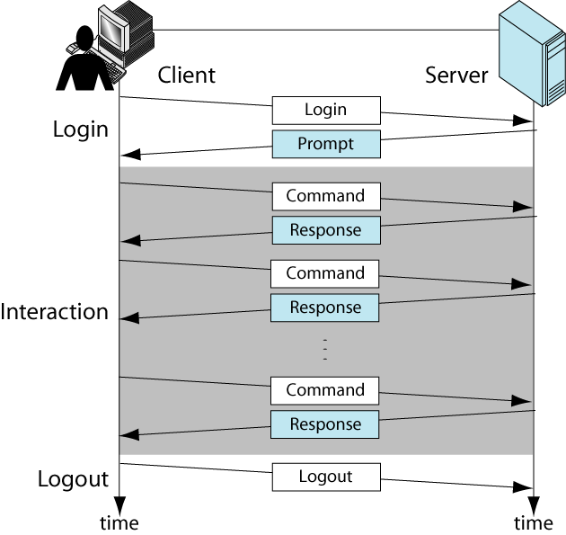
Interactive Session
The interactive session contains three steps: login, interaction, and logout.

Slide 39
Interactive Session (cont)
The default system prompt for bourn, bash, and korn shells is a dollar sign ($).
For the C and tcsh shells, the prompt is a percentage sign (%).

Slide 40
Commands
The basic of all UNIX interaction is the command.
They are generally a single line entered at the command line prompt that cause a program to be executed.
They can be included in executable files to form scripts.
All UNIX commands apply an action to some input data and create some output data.
The input usually comes from keyboard; the output is usually shown on the monitor (screen).

Slide 41
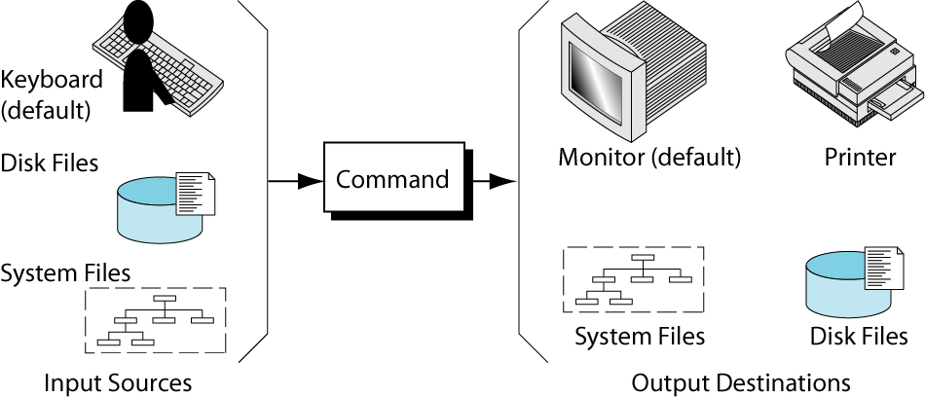
Command Source and Destination

Slide 42
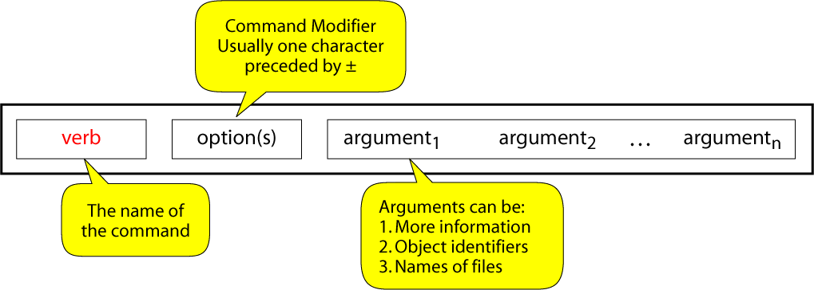
Command Syntax

Slide 43
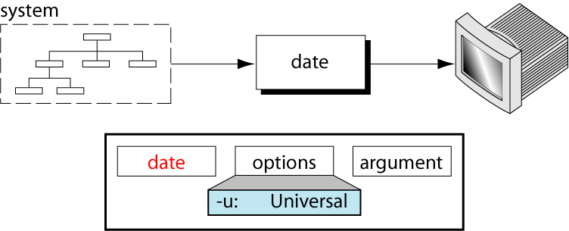
The date Command
The date command displays the system date and the time.
We can’t change date as an ordinary user but system administrator can do it.

Slide 44
Continue….
$ date
Mon Jun 15 09:30:00 IST 2015
The command can also be used with suitable format specifies as argument.
Each format is preceded by “+” symbol followed by %operator and a single character describing the format.

Slide 45
COMMAND | OUTPUT
$ date | Mon May 15 09:30:00 IST 2015
$ date +%m | 05
$ date +%h | May
$ date +”%h %m” | May 05
$ date +%d | 15
$ date +%y | 15 ( Last two digit of Year)
$ date +%H | 09
$ date +%M | 30

Slide 46
Continue….
To set current time to 09:30:30 enter : date 0930.30
To set date to 17 Jun, 09:30am : date 06170930
Try….
date "+%m/%d/%y"
date "+%Y%m%d"
date +'%-4.4h %2.1d %H:%M‘
How to display date in dd/mm/yyyy format.?

Slide 47
Time Command
It is used to determine the duration of execution of a particular command.
To use the command, simply precede any command by the word time, such as:
time ls
When the command completes, time will report how long it took to execute the ls command in terms of user CPU time, system CPU time, and real time. The output format varies between different versions of the command.

Slide 48
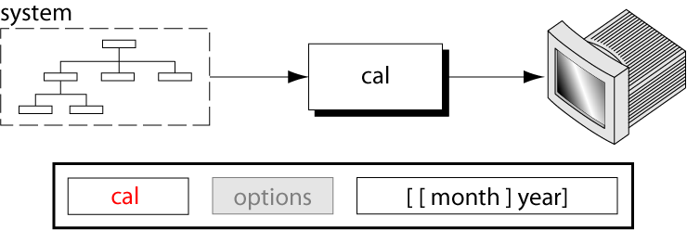
The calendar Command
The calendar command , cal, displays the calendar for a specified month or a year.
It has no options.

Slide 49
Continue….
We can not hold the calendar in one page of the screen
Remember to use <ctrl-s> to stop scrolling and <ctrl-q> to resume it.
Display calendar for 1752. Do you notice anything unusual?
Try….

Slide 50
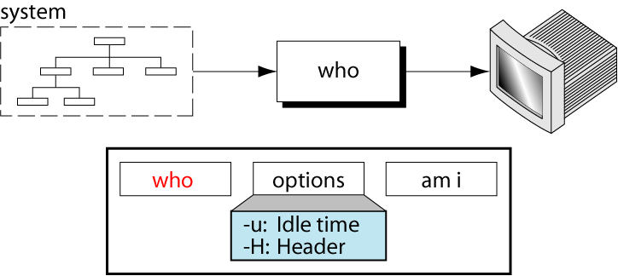
The who Command
The who command displays all the users currently logged into the system.

Slide 51
Continue….
By default, it produce 3 column output.
$who
root console jan 30 10:25
13bca01 tty01 jan 30 11:10
13bca55 tty02 jan 30 12:24
First column shows the login name of user .
Second column shows the device name of their terminals
Third column shows the date and time of logging in.

Slide 52
Continue….
-H option used to display Header
-u option used to show the logged in user list.
$who -Hu
NAME LINE TIME IDLE PID COMMENT
13bca01 tty01 jan 30 11:10 . 30
13bca55 tty02 jan 30 12:24 0:40 31
IDLE column show the time when last activity is occurred. The “.” shown against 13bca01 show that activity has occurred in last one minute before the command was invoked.

Slide 53
Who am i
Who command when used with arguments “am” and “I” display a single line output.
It display the login detains of user who issued this command.
$whoami
13bca01 tty01 jan 30 11:10:30

Slide 54
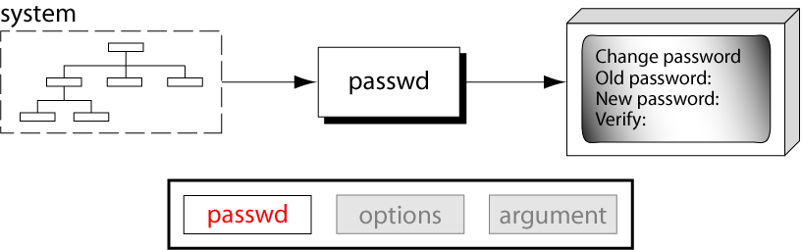
The passwd Command
The password command, passwd, is used to change your password.
It has no options or attributes.

Slide 55
Continue….
When invoked by ordinary user, asks for old password, after which it demands the new password twice.
If everything going smoothly, new password is registered by the system and $ prompt is returned.
When we enter a password, the string is encrypted by the system and stored in the file “/etc/shadow”

Slide 56
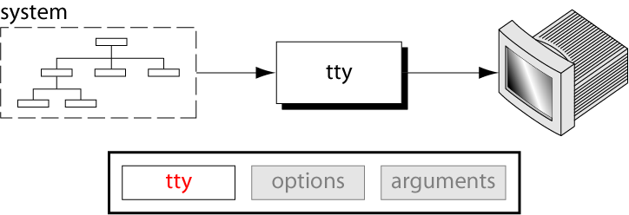
The tty Command
The tty command is used to show the name of the terminal you are using.

Slide 57
Continue….
$tty
/dev/tty01
The terminal filename is tty01 reside in /dev directory.

Slide 58
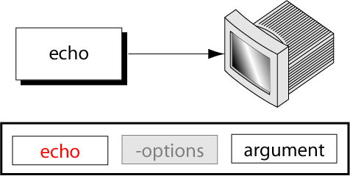
The echo Command
The echo command copies its argument back to the terminal.

Slide 59
Continue…
$ echo Good Morning
Good Morning
Echo doesn’t compress the space but the shell does.
To preserve the space, we have to place the two words within quotes
$ echo “Good Morning”
Good Morning

Slide 60
tput command
tput command is used to control the movement of the cursor on the screen as well as to add certain features like blinking, boldface and underlining to the displayed message on the screen.
There are following features available with this command.
Set the Cursor Position using tput cup
You can move the cursor to a specific row and column using tput cup. Following example positions the cursor at row 2 and column 3.
$ tput cup 2 3
If you issue echo command after that this command, you will find the echoed text at that position.

Slide 61
tput command
Clear the Screen Using tput clear
If you are in middle of the terminal screen, tput clear will clear the screen and put you at the top of the terminal screen.
$ tput clear
Get the Number of Columns and Lines of a Terminal
To display the number of columns of your terminal screen, do the following.
$ tput cols
142
Following displays number of lines of your terminal screen.
$ tput lines
48

Slide 62
tput command
Execute Multiple tput Commands
tput allows you to run set of commands in a single time. For example, if you want to clear the screen and set cursor to a particular position, do the following.
$ tput -S <<END
> clear
> cup 2 4
> END
5. Change the Terminal Background Color using tput setb
Using tput, the background color of the screen can be changed as shown below.
$ tput setb 4

Slide 63
tput command
Underline Text using smul and rmul
Start the underline mode:
$ tput smul
Stop the underline mode:
$ tput rmul
In the below example, it underlines the ‘guide’ text by using smul and rmul capabilities of tput.
$ echo `tput smul`guide`tput rmul`
guide

Slide 64
tput command
Boldface text using smso and rmso arguments
Start the boldface mode:
$ tput smso # Highlight starts
Stop the boldface mode:
$ tput rmso #Highlight end.
$ echo `tput smso `OM` tput rmso`

Slide 65
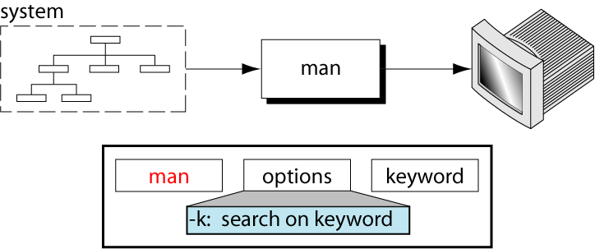
The man Command
The man command displays online documentation.
-k option will display information about a topic.

Slide 66
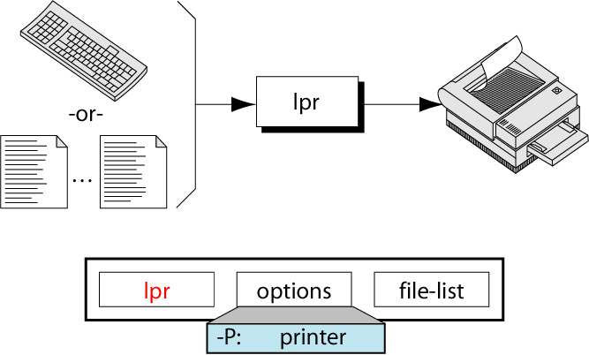
The lpr Command
The common print utility is line printer (lpr).

Slide 67
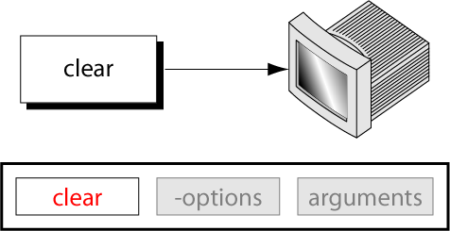
The clear Command
The clear command clears the screen and puts the cursor at the top.

Slide 68
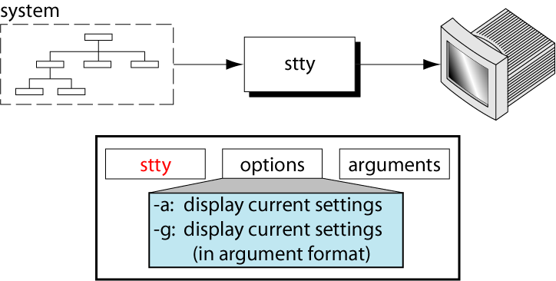
The stty Command
The set terminal (stty) command sets or unsets selected terminal I/O options.
When the terminal is not responding properly, the set terminal command can be used to reconfigure it.

Slide 69
Set Terminal with Arguments
Set Erase and Kill (ek) The ek argument sets the default erase (Delete key ctrl+h) and kill (ctrl+c) to their defaults.
Set terminal to General Configuration (sane) The sane argument sets the default terminal configuration to a reasonable setting that can be used with majority of terminals. stty sane
Set Erase key (erase) By default, the Erase key is ctrl+h. We can reconfigure the keyboard to use another key as the Delete key. stty erase ^e

Slide 70
Set Terminal with Arguments (cont)
Set Kill (kill) The Kill key deletes a whole line. By default it is ctrl+u. We can change it using the set terminal command with the kill argument stty kill 9
It is not recommended to use a single key.
Set Interrupt Key (intr) The interrupt key interrupts or suspends a command. By default it is ctrl+c. It can be reset using intr argument stty intr ^9
There are many more stty command options and arguments. Many of them are applicable only to superusers.
Notes:
uma

Slide 71
The script Command
The script command can be used to record an interactive session in a file typescript in the current directory.
All the command, output and the error message are stored in the file for later viewing.
If we are doing some important task, and wish to keep a log of all out activities then we should invoke this command immediately after log in.
$ script
Script started, file is typescript
The prompt returns and all your keystrokes we enter get recorded into typescript .

Slide 72
Continue…
To stop recording, key exit.
$ exit
Script done , file is typescript
typescript is a default file name.
We can append data into file using “-a” otion
$ script -a
We can pass a file name as an argument with our choise
$ script myfilename # Session recorded into file “myfilename”

Slide 73
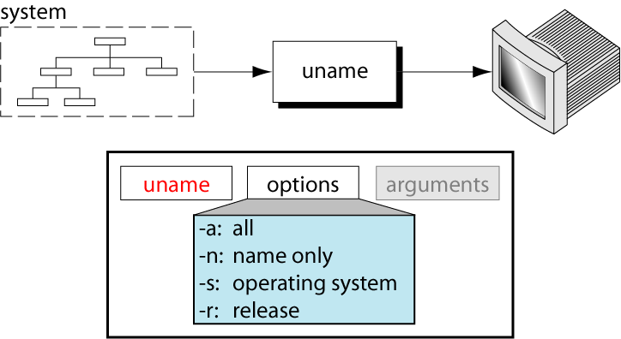
The uname Command
UNIX system stores data about itself. To see these data, we can use the uname command.
It Print machine information.

Slide 74
OPTION | DESCRITION
-a | Print all information
-n | Print network node hostname
-s | Print kernel name
-r | Print kernel release

Slide 75
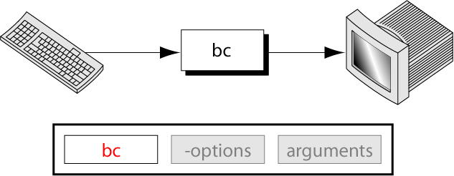
The bc Command
bc command turns UNIX into a calculator.
To terminate it, we key ctrl+d.
scale expression sets the number of digits after the decimal point.
The base of the calculation can be changed by setting the input base (ibase) and the output base (obase).

Slide 76
Continue…
When invoked without arguments, the input has to be keyed in , each line terminate.
$ bc
12 + 5 Display valued after completion
17 <ctrl + d>
$
We can also use “bc” to perform the calculation together
12 * 12 ; 2^3
144
8
When we divide two number, output will be truncated
9 /5
1

Slide 77
Continue…
We have to set “scale” to the number of digits of precision before we perform division
$ bc
Scale = 2
27/7
2.42 # actual result is 2.42857 but we set scale = 2
“bc” comes useful when converting numbers from one base to the others using “ibase (input base) ”. It is useful when setting IP address in network , we need to convert binary number to decimal.
Ibase=2
11001010
202

Slide 78
Continue…
The reverse is also possible using “obase”
obase=2
202
11001010
“bc” can also used with variables that retain their values until you exit the program.
“bc” support single lowercase letters.
x=3;y=4;z=5;
P=x+y+z
P
12

Slide 79
Spell command
This command is used to check your spellings.
It takes the name of the file as argument and generates a list of all spellings that are program recognize as mistake.
$ spell test.txt
Admintrators
Computator
Communicatin
Daemon
First 3 are mistakes but 4th one is right but spell doesn’t sense it.
By default, the spellings are checked with reference to the US directory but we can use “-b (British)” option to use different one.

Slide 80
iSpell command
Spell is not interactive means we cant correct the mistakes.
Ispell is highlights the line and the word , suggest some alternatives and offers other options.

Slide 81
Lock command
Used to lock the terminal.
Sometimes we need to go away from our terminal for a while, and don’t want to log out because job is running in the background.
Lock terminal to prevent people with mischievous intent from gaining access to the system.
It require to enter a password when we want to lock terminal.
$ lock
Password:
Re-enter Password:
Terminal locked by 13bca01 0 minutes ago

Slide 82
Lock command
The $ prompt disappear and system will remain lock in this condition for 30 minutes. If we cant back by that time, then it will log out.
Unlock it by entering password.
Set duration to lock by using option
$ lock -45 # lock 45 min.
These parameters are variable and controlled by two setting in file /etc/default/lock

